Slide 1
Acker, A. Data Craft: The Manipulation of Social Media Metadata.
Naga Vamsi Krishna Pabbisetty
Web Archiving Forensics (CS 795/895)
Old Dominion University
2019/04/03

Slide 2
Manipulation of Data
Celebrities/Politicians – famous/popular
Generate clicks/fake engagement through astroturfing and botnets
International marketplace for followers/clicks to promote celebrity profiles/fake reviews/followers/views/others
Platforms respond by locking down, deleting accounts with “bot sweeps” and the mass deletion of fake accounts
Moderation of politically motivated manipulation has proven difficult

Slide 3
Problem being faced
Discerning if a user is real and his activities are authentic from fake/spammy/malicious manipulations

Slide 4
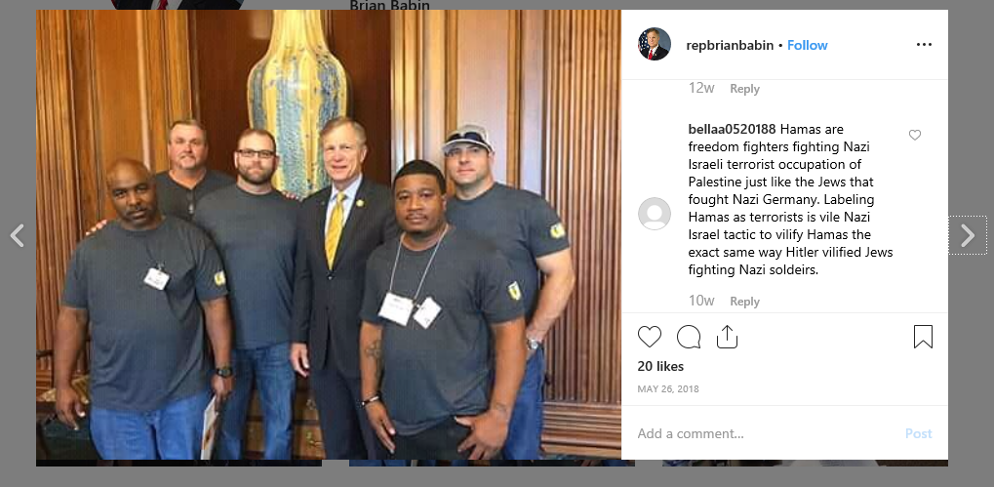
Differentiating Content and Metadata
https://www.instagram.com/p/BjPcVlcH9QM/

Slide 5
Content and Metadata
Content – Photo, Post
Metadata - Account Image, Account Name, Number of Likes, Tag, Date of Post
Additional Metadata from the API
location_id
profile_views
created_time
source

Slide 6
Uses of Metadata
Acts as sign posts for transmission, access, and retrieval of information
Are a core part of how we experience platforms(e.g., likes, shares and more)
Can be applied flexibly to find, retrieve, or even provide new paths to accessing content in platforms and across the internet
Gives a new perspective to look at as new ways are required
With ease you can check social media accounts with the most followers, games with maximum downloads and others

Slide 7
The Need to read metadata
Validating or disputing social media data through metadata helps us understand media manipulators craftiness
Understanding this would help the platforms do better in their efforts at challenging falsified content

Slide 8
One Person’s Metadata Are Another Person’s Data
There are many definitions for metadata
A working definition of metadata is the names that represent aggregated data
Few distinctions of metadata from data are done by contexts of creation, collection, and use but its definition by context should not be unquestionable because collections of data may change over time
The designation of metadata changes in question to the user and his purpose

Slide 9
Aleksandr Kogan’s “This Is Your Digital Life” App
Cambridge Analytica breach
Collected user profile data from Facebook
Also collected data about friends (as part of metadata as per then facebook norms)
Collected data on millions of users without their interaction
Stopped collecting data in 2014 (after an update by Facebook)
Reason – borderline differentiation between data and metadata

Slide 10
Data Craft
A skill set at manipulating metadata, a craftwork that plays with the features and automated operations of platforms
It can also be known as a collection of practices that affect social media by creating/relying on/play with the proliferation of its data

Slide 11
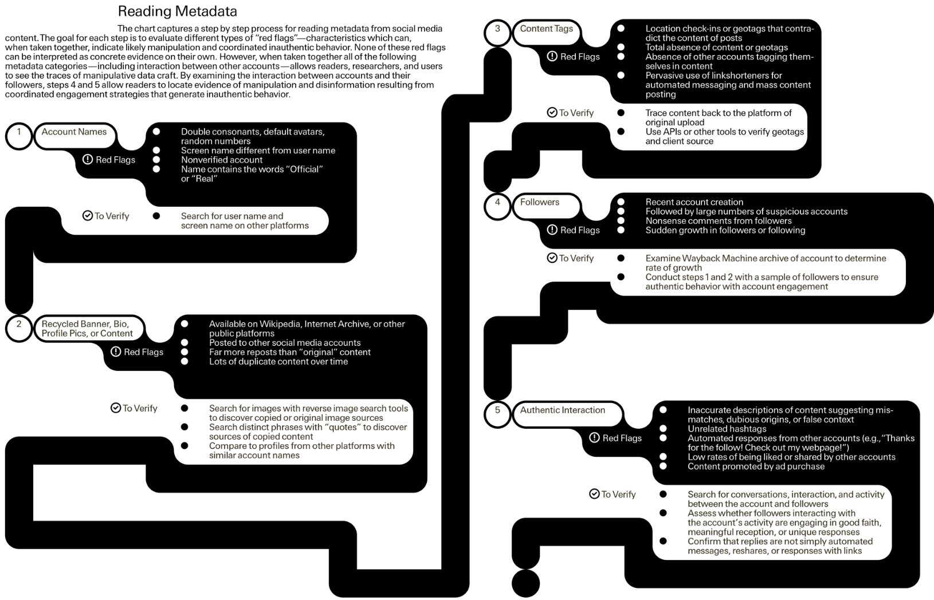
Reading Metadata

Slide 12
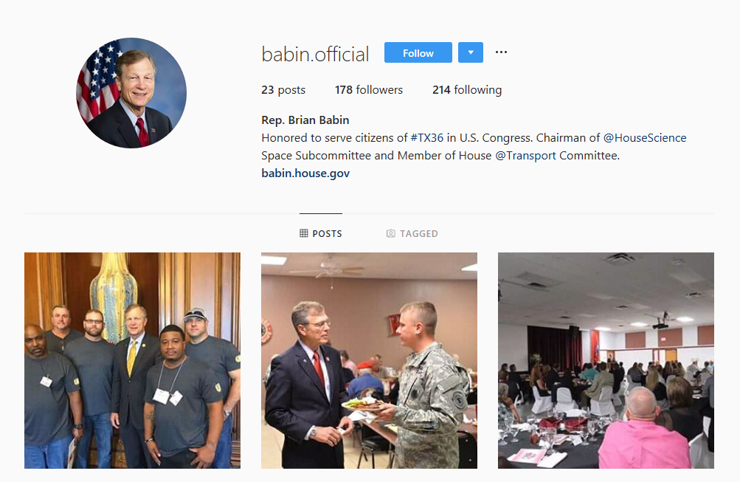
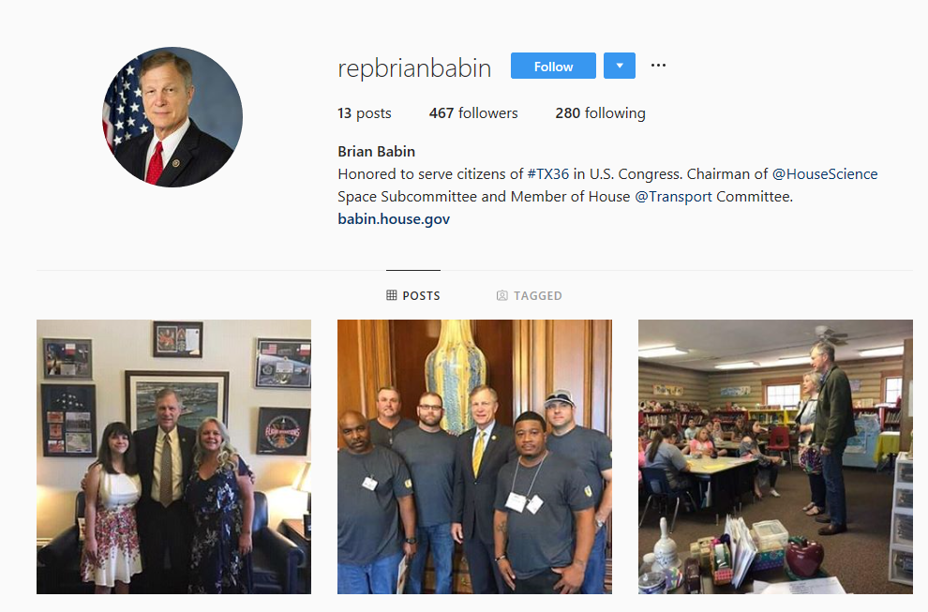
Babin on Instagram: Mimicking Legitimacy
https://www.instagram.com/babin.official/
https://www.instagram.com/repbrianbabin/

Slide 13
Reason behind this?
Disinformation?
Malicious?
A spam?
An early example of election meddling
Or just a way to get more followers and more engagement?
Or something else?

Slide 14
Why did automated moderation fail to detect this fake account?
Both are not verified
Posts, tags, comments, descriptions
Original account was tagged by Representative Phil Roe and a former staffer
More description in each post by the original
All the posts by the fake account are 2 days younger
Low risk of being detected by moderation techniques

Slide 15
Pointers – Is the account legitimate?
Search for real name/username/account handle across other platforms and compare profile picture
Identify posts and timestamps of the copies
Profile pics and account banners – reverse google image search
Locate absences that have not been copied or backfilled (e.g., lack of comments, description, etc.)
Check if an account has been tagged by other verifiable platform users
Consider parody or organizational change as explanations before concluding that something is malicious manipulation

Slide 16
Creating Imposter Accounts: Claiming Deleted Screen Names
Justin Littman, an archivist at George Washington University Libraries
Found that 100 deleted and 29 suspended government accounts listed in Digital Registry as active
Targeted @USEmbassyRiyadh handle
Created new account and changed its official banner image, profile, name, location, and other metadata to that of @USEmbassyRiyadh from the Internet Archive
Posted in the name of U.S. Embassy Riyadh and removed the account

Slide 17
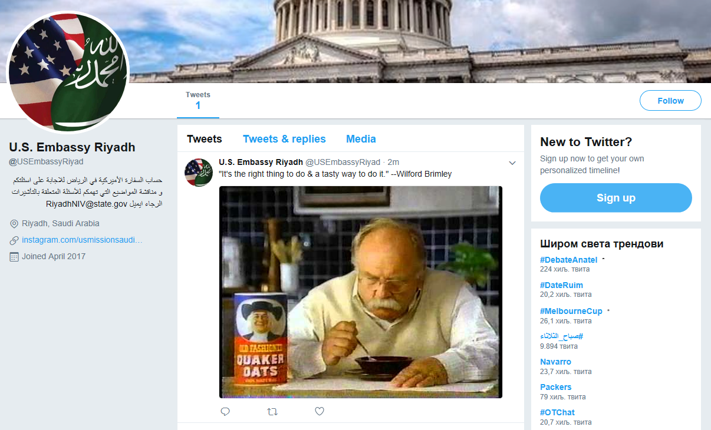
Littman’s Experiment
https://web.archive.org/web/20171107045700/https:/twitter.com/USEmbassyRiyad

Slide 18
Pointers – Real or an imposter?
Date of account origin
Number of tweets/posts
Media attached
Check for the last activity if the account is dormant
If listed official, check homepage to confirm
Reverse Google image search the profile pics and banners
Check for the authenticity of followers and commenters

Slide 19
Facebook Internet Research Agency Ads
3,517 Facebook and Instagram ads were purchased and used during 2016 presidential elections
80,000 organic posts
Facebook submitted all the add in a PDF – difficult to extract
Digital archivist Ed Summers – created software to extract images and metadata from the PDF into JASON files
Developer Simon Willison – wrote software to convert JASON files into searchable database

Slide 20
Williams&Kalvin account
Run by Russian manipulators
Posted content that appeared across YouTube, Facebook, and Twitter
Initially posted about police brutality and racism and was consistent with some Black Lives Matter social media content
Once popular, posted anti-Clinton content frequently near 2016 elections

Slide 21
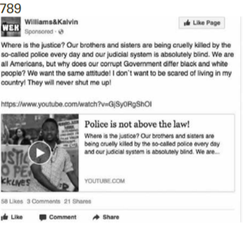
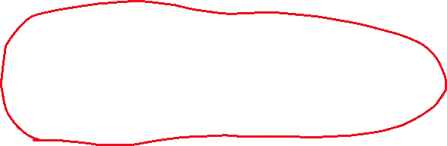
AD#789
Where is the Justice? Our brothers are being cruelly killed by the so-called police every day and our judicial system is absolutely blind. We are all Americans, but why does our corrupt Government differ black and white people? We want the same attitude! I don’t want to be scared of living in my country! They will never shut me up!
Targeting Interest matches and ethnic interested groups
Similar examples may include BlackNews.com or “HuffPost Black Voices” articles

Slide 22
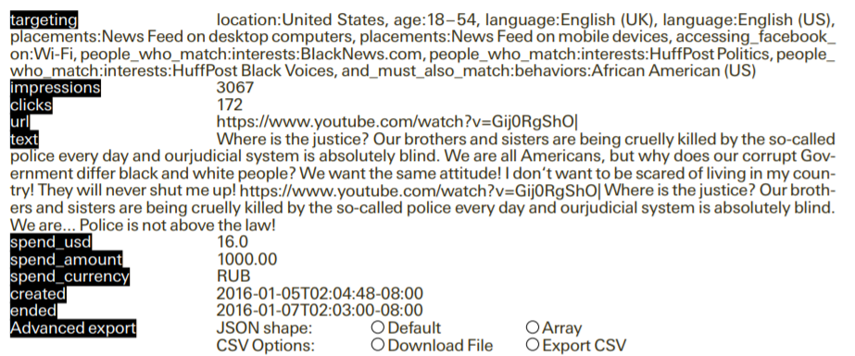
AD#789

Slide 23
Pointers
Check account creation time and date, check post rate per day
Examine promoted posts and ads policies of platforms, research
Examine how often content is shared(e.g., changes in the captions and other)

Slide 24
Take away
With growing number of ways to detect, remove and prevent disinformation posts that manipulate, new methods of data craft as well grow in number
The core of all this is the metadata
Read the metadata to validate or dispute social media to understand the datacraft

